Slide 1
Towards a Unified NR Reduction in Mantid (herding cats) Maximilian Skoda

Slide 2
Acknowledgements
Mantid Team
Owen Arnold
Raquel Alvarez-Banos
Ed Brown
Mathieu Doucet
Gemma Guest
Sam Jones
Verena Reimund
Alice Russell
Antti Soininen
Roman Tolchenov
ILL
Philip Gutfreund
Thomas Saerbeck
SNS
John Ankner
Jim Browning
Tim Charlton
Artur Glavic (PSI)
Valeria Lauter
ESS
Simon Heybrock Thomas Holm Rod
Jon Taylor
ISIS
Andrew Caruana
Jos Cooper
Rob Dalgliesh
Christy Kinane
Nina-Juliane Steinke

Slide 3
Why?
Better use of resources (developers/scientists/software)
More thorough testing and validation
Faster bug finding
Ease of use?
Good for users – same experience at different facilities
Towards generalized data reduction on a chopper-based time-of-flight neutron reflectometer
Gutfreund et al. (2018) J Appl Crystallogr.

Slide 4
“Life is really simple, but we insist on making it complicated.”
Confucius
“Abandon the urge to simplify everything, to look for formulas and easy answers, and to begin to think multidimensionally, to glory in the mystery and paradoxes of life, not to be dismayed by the multitude of causes and consequences that are inherent in each experience - to appreciate the fact that life is complex.”
M. Scott Peck

Slide 5
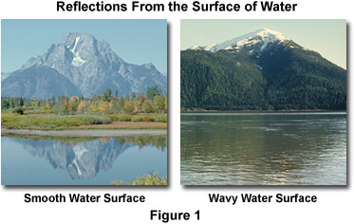
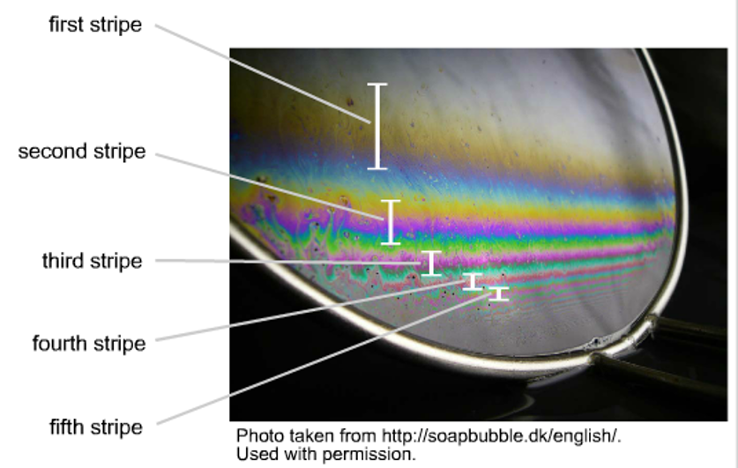
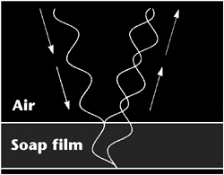
What is Reflectometry?

Slide 6
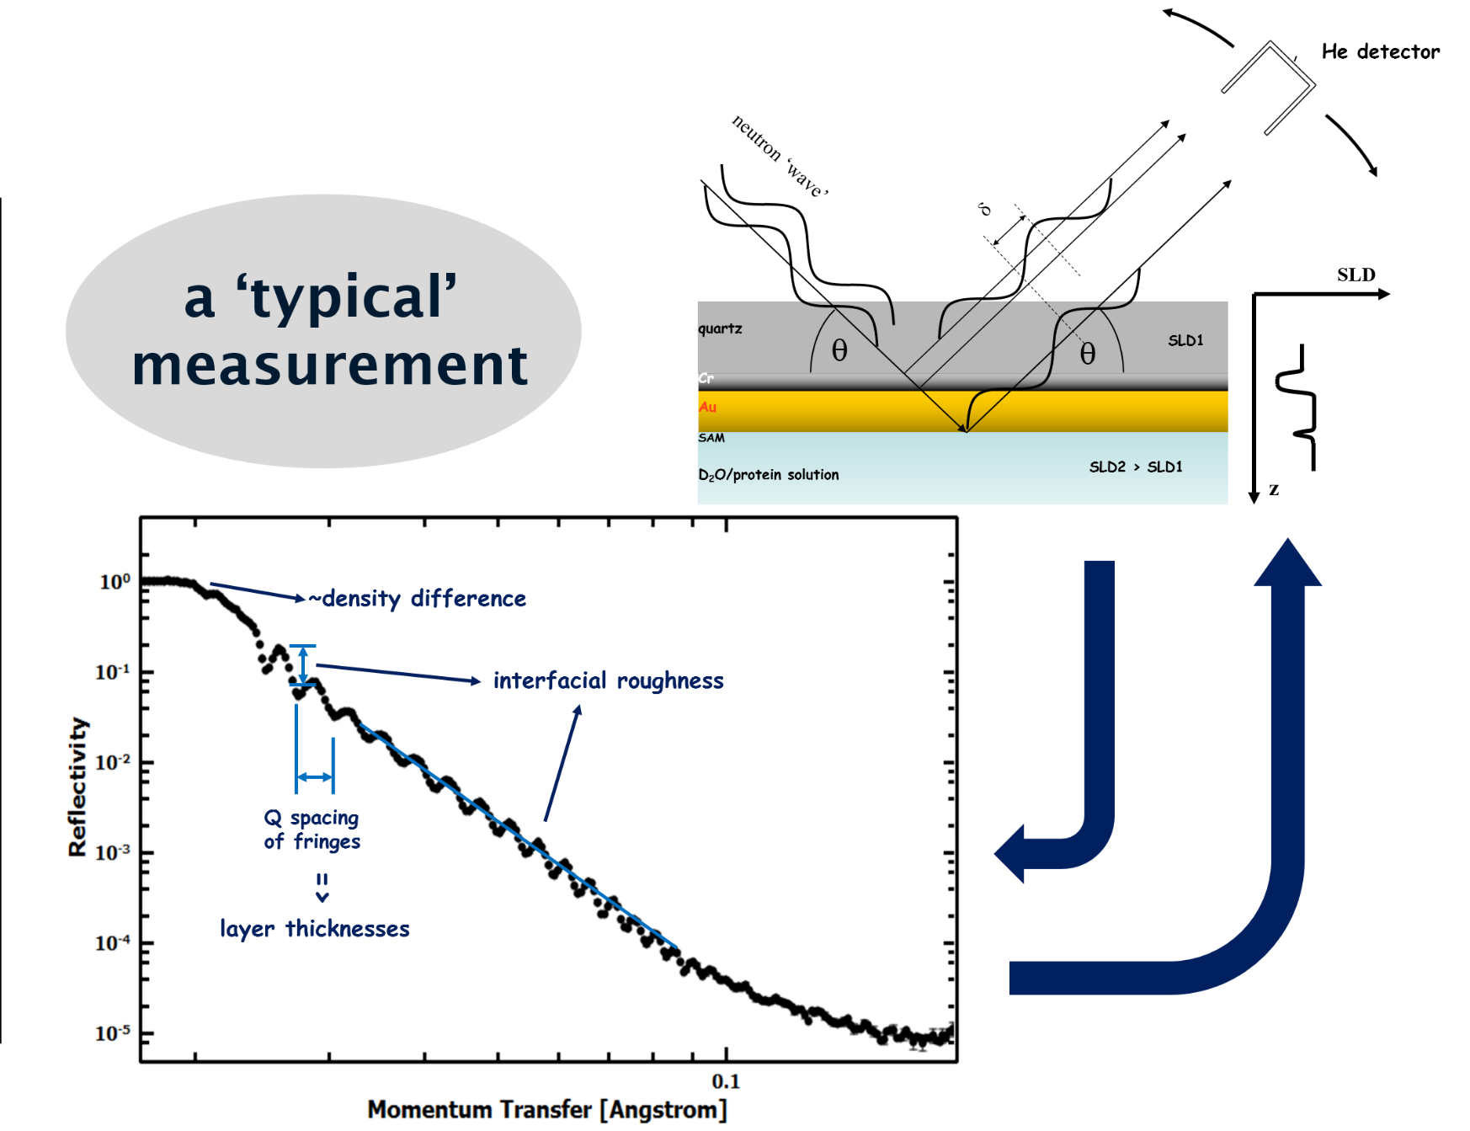
What is Reflectometry?

Slide 7
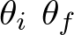
What is Reflectometry?
x
Q_{x}
information about out-of-plane structure
z
Q
Q_{z}
information about in-plane structure
SLD
quartz
SLD1
Cr
Au
SAM
D₂O/protein solution
SLD2 > SLD1
z

Slide 8
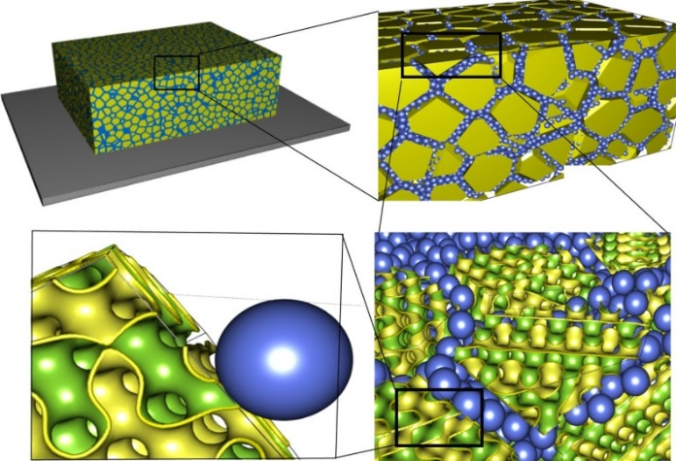
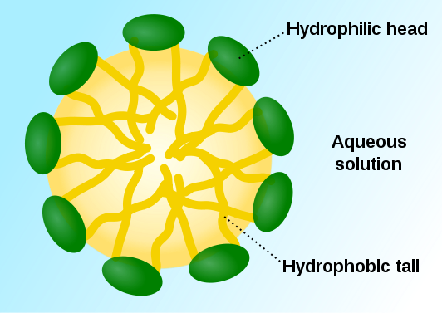
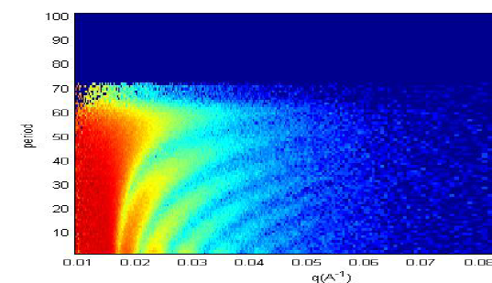
What can reflectivity do for us?
measure layers from 1nm to several 100nm
buried layers
interfacial roughness
layer density and composition
Applications
Surfactants Proteins Ionic liquids Drug delivery Polymer films | Wetting phenomena Rheology Electrochemistry/Batteries Corrosion Kinetic studies

Slide 9
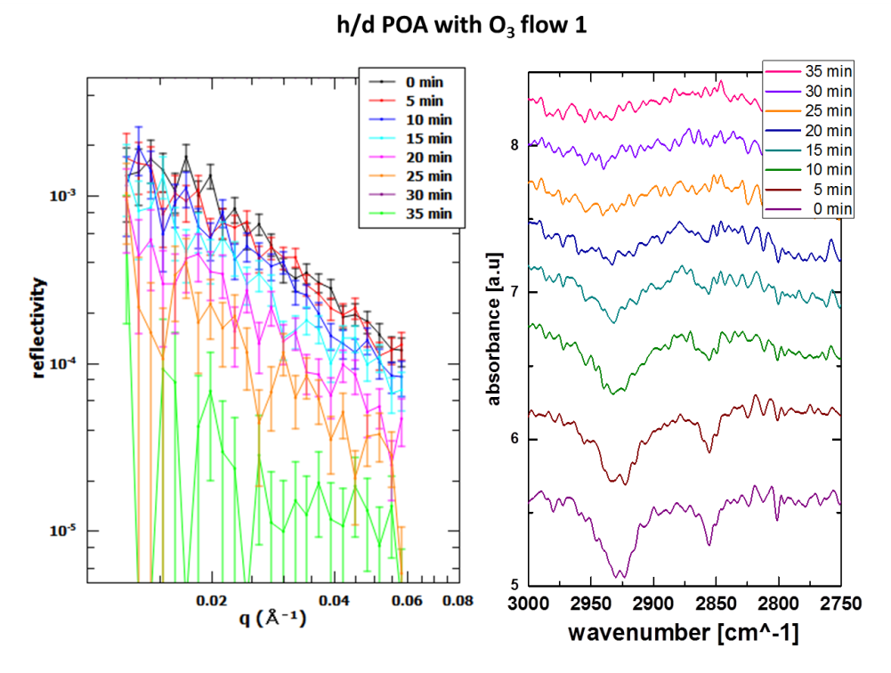
Some Examples

Slide 10
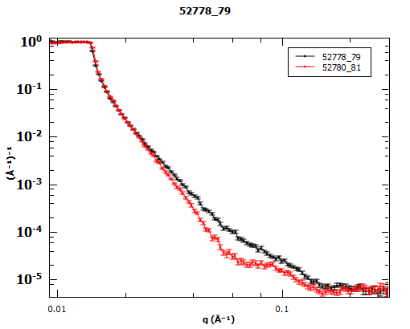
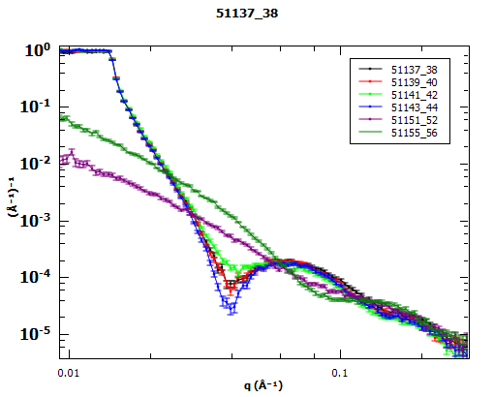
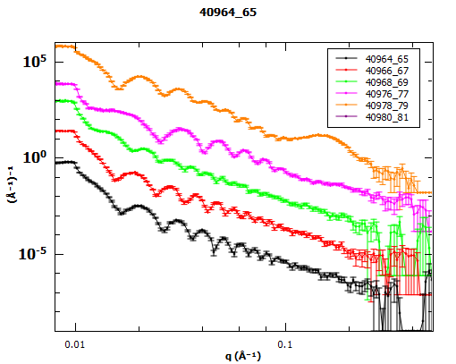
‘Typical’ Data

Slide 11
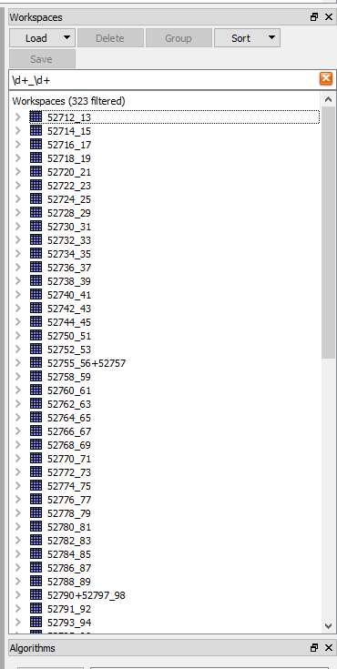
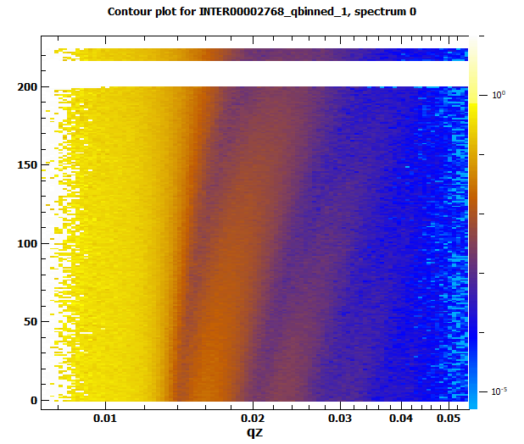
Time-resolved Measurements
Physical changes: polymer annealing
Time / 30 s

Slide 12
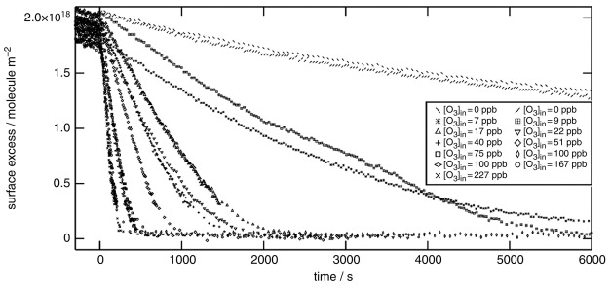
Time-resolved Measurements
Chemical reactions: oxidation of fatty acids
Pfrang et al. (2014) PCCP.
1–30 s per measurement:
1–3 s at the start of the reaction then
20–30 s towards the end of the reaction

Slide 13
Comparison with Other Techniques
Reflectometry | SANS/ Crystallography / Excitations
1 to 100s detector channels | 10³-10⁵ detector channels
Detectors moving | Detectors fixed
Small(ish) datasets | Larger datasets
Data reduction mathematically simple | Data reduction mathematically often more complex
2D Workspaces – lots of them | MD Workspaces

Slide 14
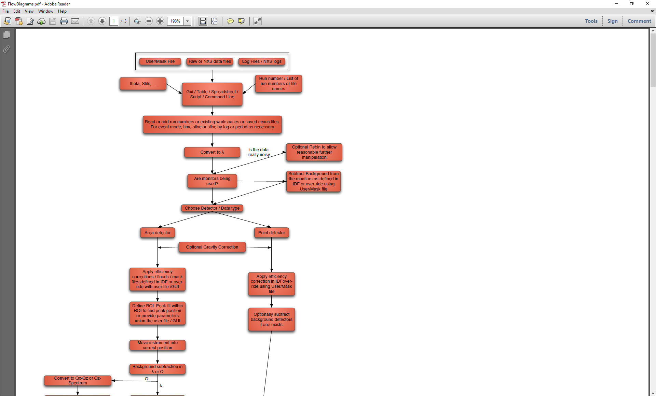
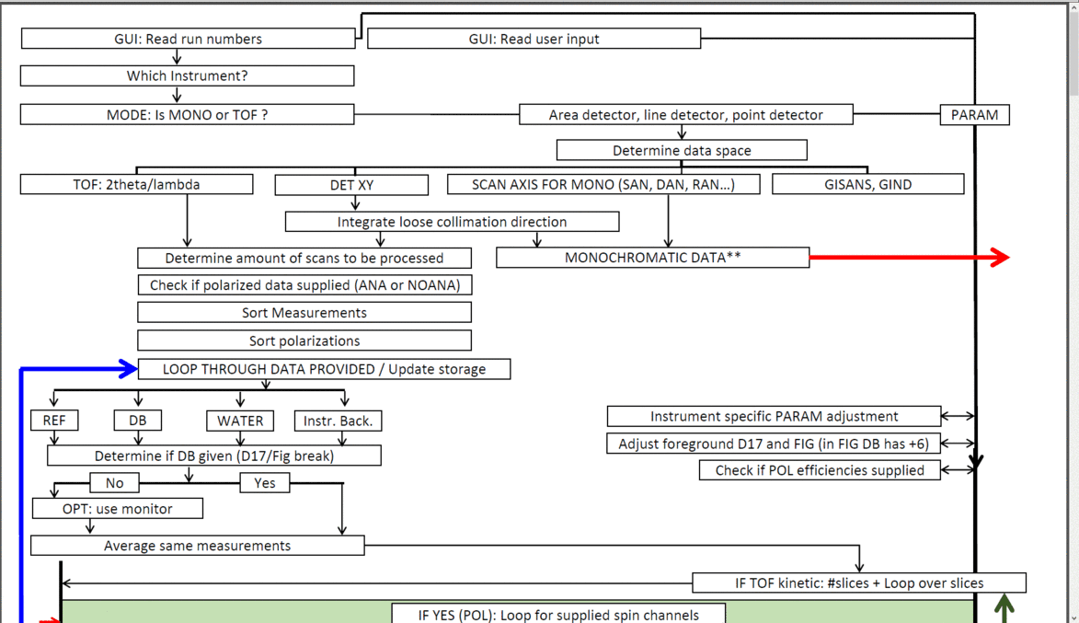
Reflectivity Data Reduction
What is needed?
In broad terms:
Some corrections
Some unit conversions
Ease of use / AutoProcess®
In detail:
Flowchart
GUI

Slide 15
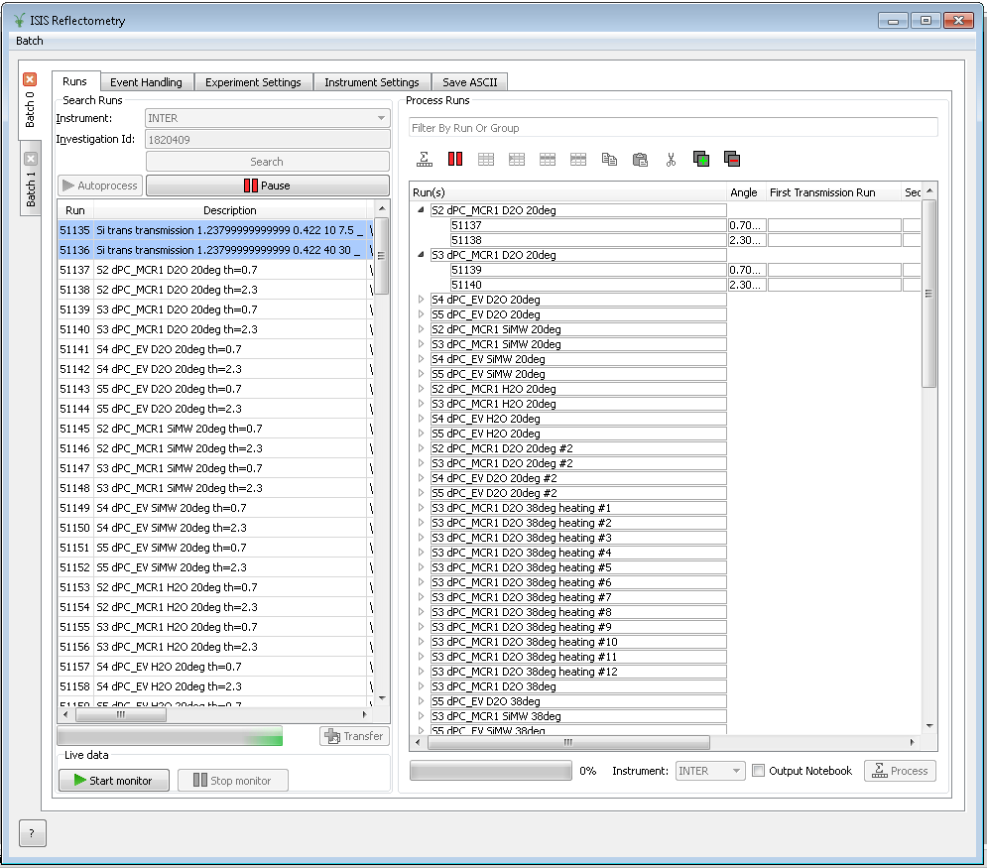
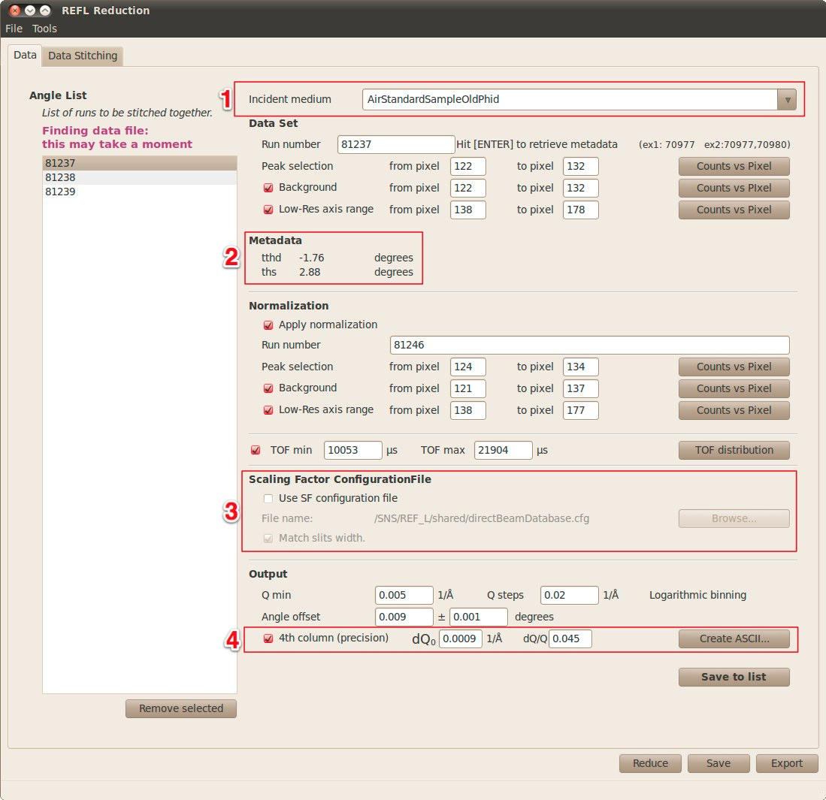
Progress to Date
Have started talking in more detail (scientists and developers)
Have largely agreed on correction types (transmission, polarisation, flood, background etc.)
Using some common algorithms:
5 ISIS reflectometers:
ExtractPolarizationEfficiencies, CreatePolarizationEfficiencies
PolarizationEfficiencyCor
PolynomialCorrection, Exponential correction
CalculateFlatBackground
GroupDetectors (to sum in lambda)
CreateFloodWorkspace
ApplyFloodWorkspace
ISIS, SNS, ILL:
Stitch1DMany
SaveReflectometryAscii
PolarizationEfficiencyCor
GravityCorretion (in progress)
Problems…?

Slide 16
Proliferation of Algorithms
C ConvertToReflectometryQ CreatePolarizationEfficiencies CreateTransmissionWorkspace F FindReflectometryLines I ISIS Reflectometry J JoinISISPolarizationEfficiencies L LoadISISPolarizationEfficiencies P PolarizationCorrectionFredrikze PolarizationCorrectionWildes PolarizationEfficiencyCor | R ReflectometryBackgroundSubtraction ReflectometryBeamStatistics ReflectometryMomentumTransfer ReflectometryReductionOne ReflectometryReductionOneLiveData R ReflectometrySliceEventWorkspace ReflectometrySumInQ S SaveReflectometryAscii SpecularReflectionCalculateTheta SpecularReflectionPositionCorrect Stitch1D Stitch1DMany

Slide 17
Proliferation of Algorithms
SNS L LRAutoReduction LRDirectBeamSort LRPeakSelection LRPrimaryFraction LRReflectivityOutput LRScalingFactors LRSubtractAverageBackground LiquidsReflectometryReduction M MRFilterCrossSections MRGetTheta MRInspectData | ILL F FindReflectometryLines L LoadILLPolarizationFactors LoadILLReflectometry R ReflectometryBeamStatistics ReflectometryILLConvertToQ ReflectometryILLPolarizationCor ReflectometryILLPreprocess ReflectometryILLSumForeground R ReflectometryMomentumTransfer ReflectometrySumInQ S SaveReflectometryAscii

Slide 18
Other Issues
Problems with IDFs (beam path, detector geometry)
Geometry/Source differences
System tests
Validation
Individual preferences

Slide 19
Conclusion and Outlook
We have made a start:
5 ISIS reflectometers use same code (sort of)
agreed (sort of) on building blocks for reduction (ISIS, ILL, SNS, ESS?)
We are still diverging
Can we do more (e.g. more specific/unique algorithms)?
Should we do more?
“The definition of genius is taking the complex and making it simple.” - Einstein

